Slide 1



Retreat Mini Session #3
FOOD ACCESS INITIATIVES
Monday May 24th, 2021, 1-2PM
Notes:
Audrey

Slide 2

Introduce yourself in the chat box!
Notes:
Audrey
Poll 1 (Lakin)

Slide 3
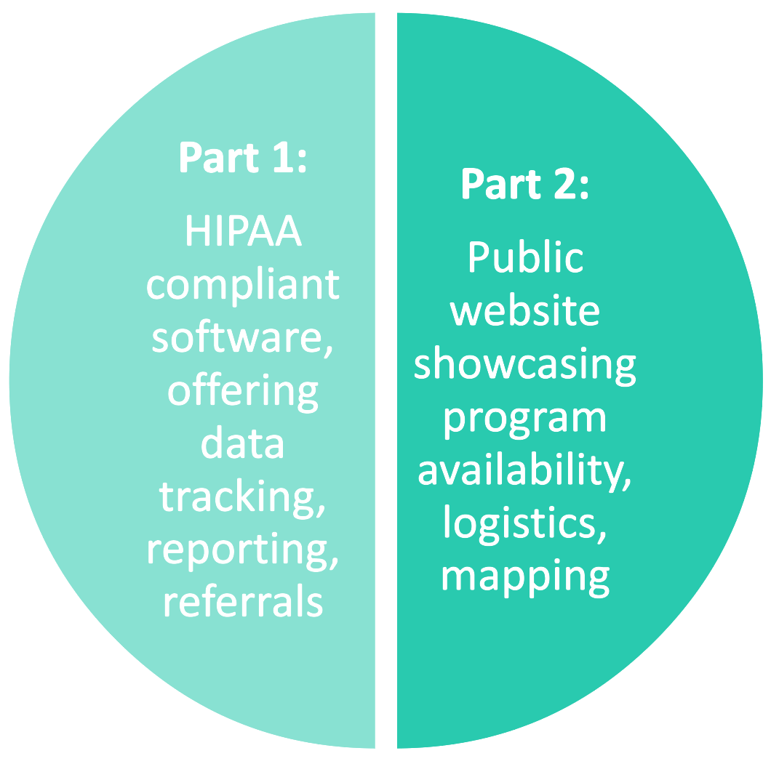
WV Health Connection
Helping to address our long-standing challenges in integrating and mobilizing across clinical and community settings for the sake of individuals, families and community/ population health
Direct technical assistance to clinical and community-based partners
Supports:
  Knowledge of available community-based programming
  Willingness and ability to refer to program offerings
  Ability to measure effectiveness of programming and demonstrate value
  Communication and therefore collaboration
  Sense of a collective response to critical public health issues in communities, regions, and the state
Notes:
Samantha

Slide 4





Sincere thanks to our funders and supporters!

Slide 5

Food Access Initiatives
Notes:
Audrey/Lakin

Slide 6
Dr. Lauri Andress
The food system and food access in West Virginia
Notes:
10-12 minutes

Slide 7
“Provide a full retail experience that accommodates the preferences of everyone in West Virginia, especially its low wealth communities, with (healthy) food options that are affordable, available, acceptable, and accessible”
Vision Statement
Mapping the Food Desert Conversation in West Virginia

Slide 8
Vision Statement
How are we -as a state- falling short of meeting this goal? Where are there gaps, what is missing?
What’s one or two ways in which we as a state could make progress towards this goal? What would we need to do?
Accommodating - Are vendors and retailers aware of consumers’ needs?
Acceptable - Does the food fit the taste and culture of consumers? (e.g. seniors - eat small portions)
Available - Is the food present?
Accessible - Can consumers get to it?
Affordable - Can consumers afford it?

Slide 12
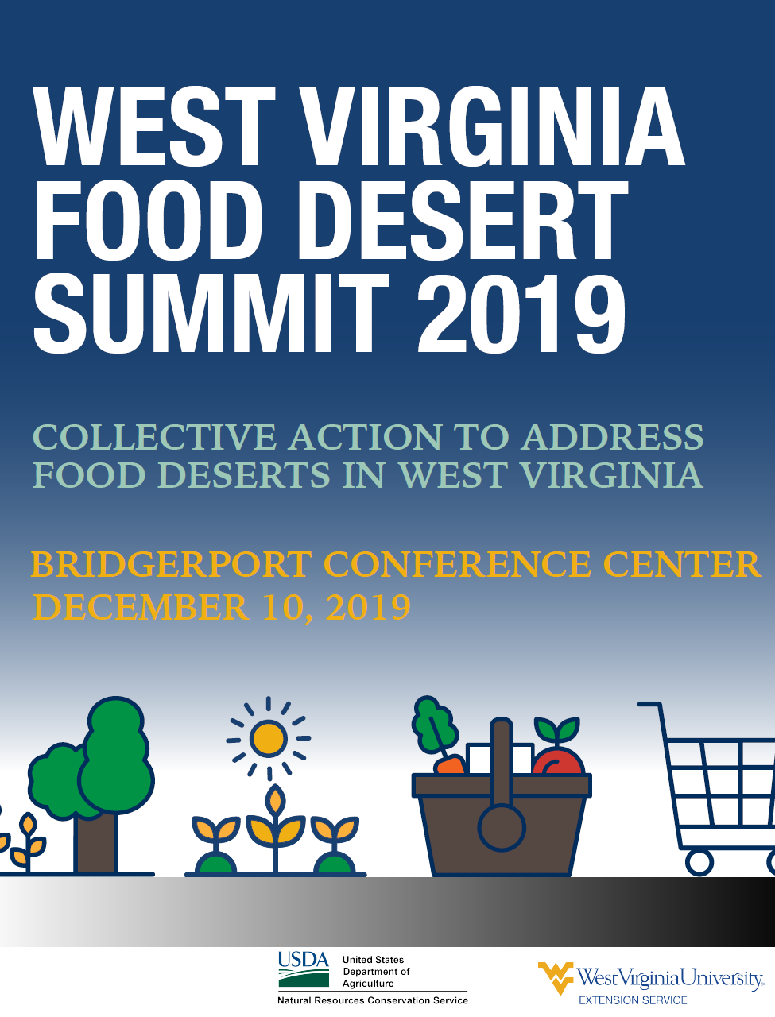
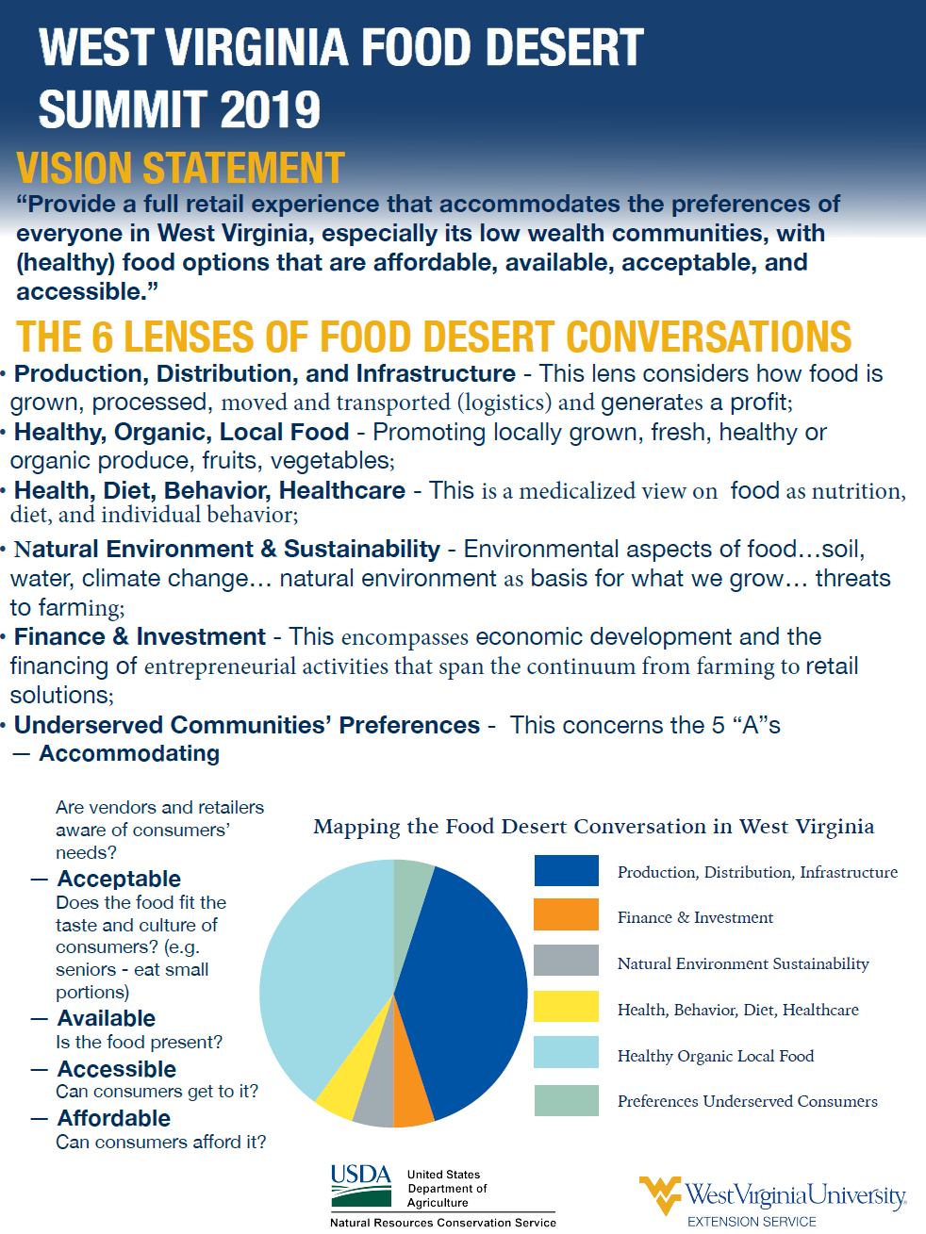

Slide 13
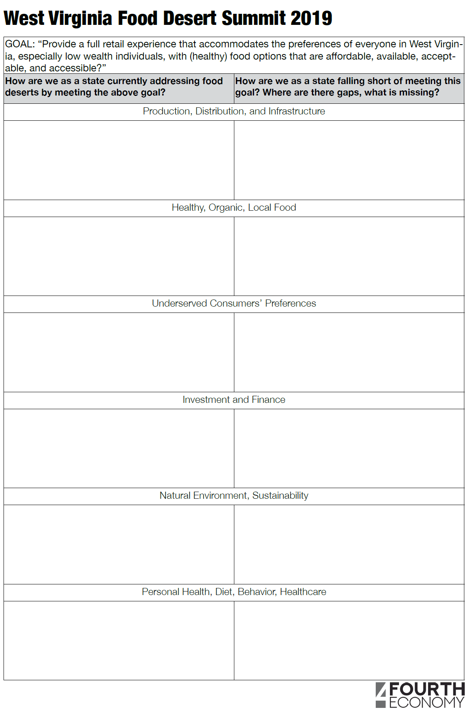
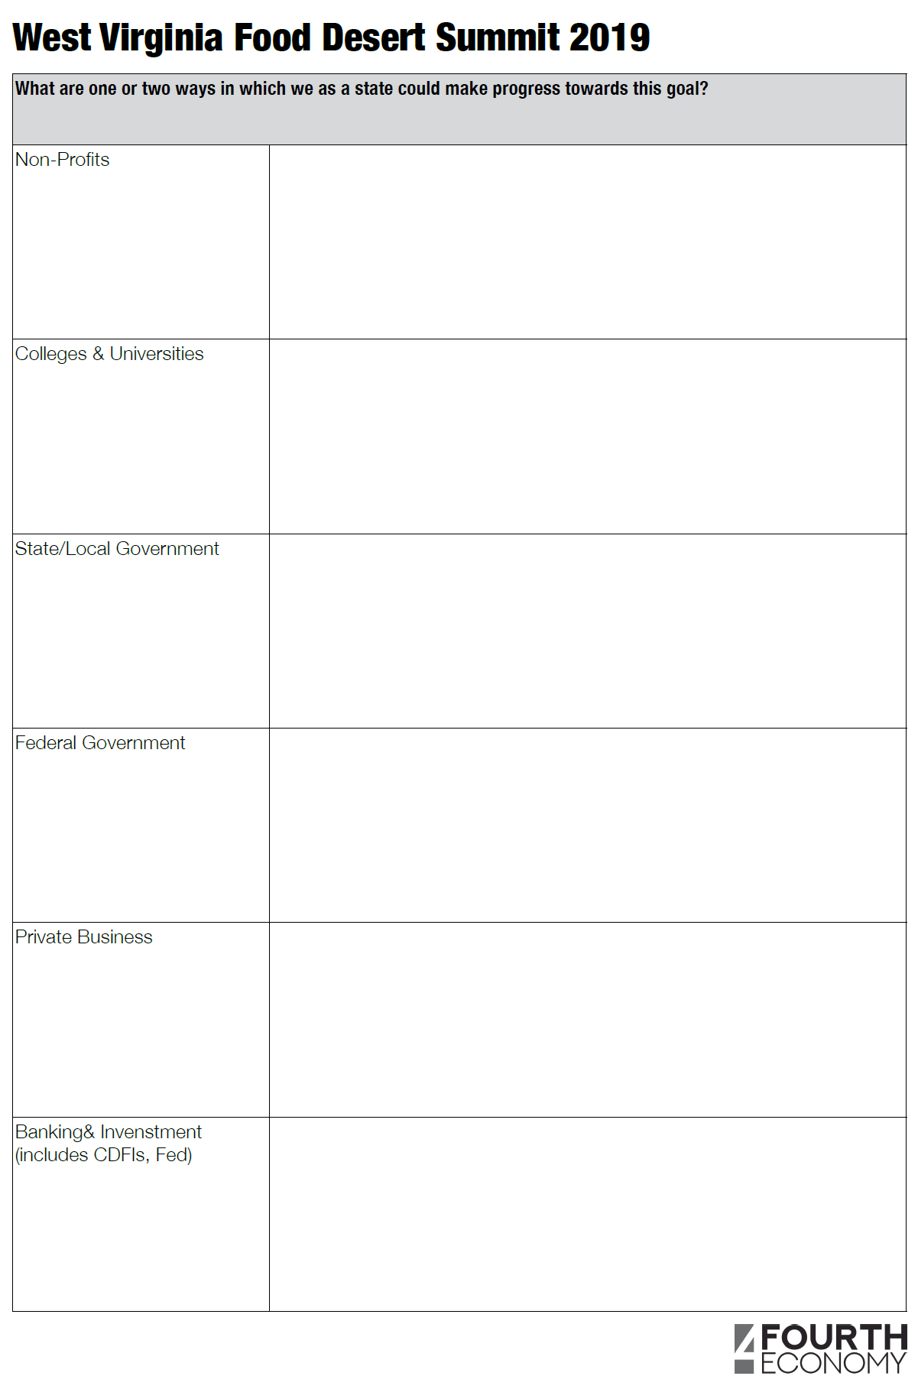

Slide 14
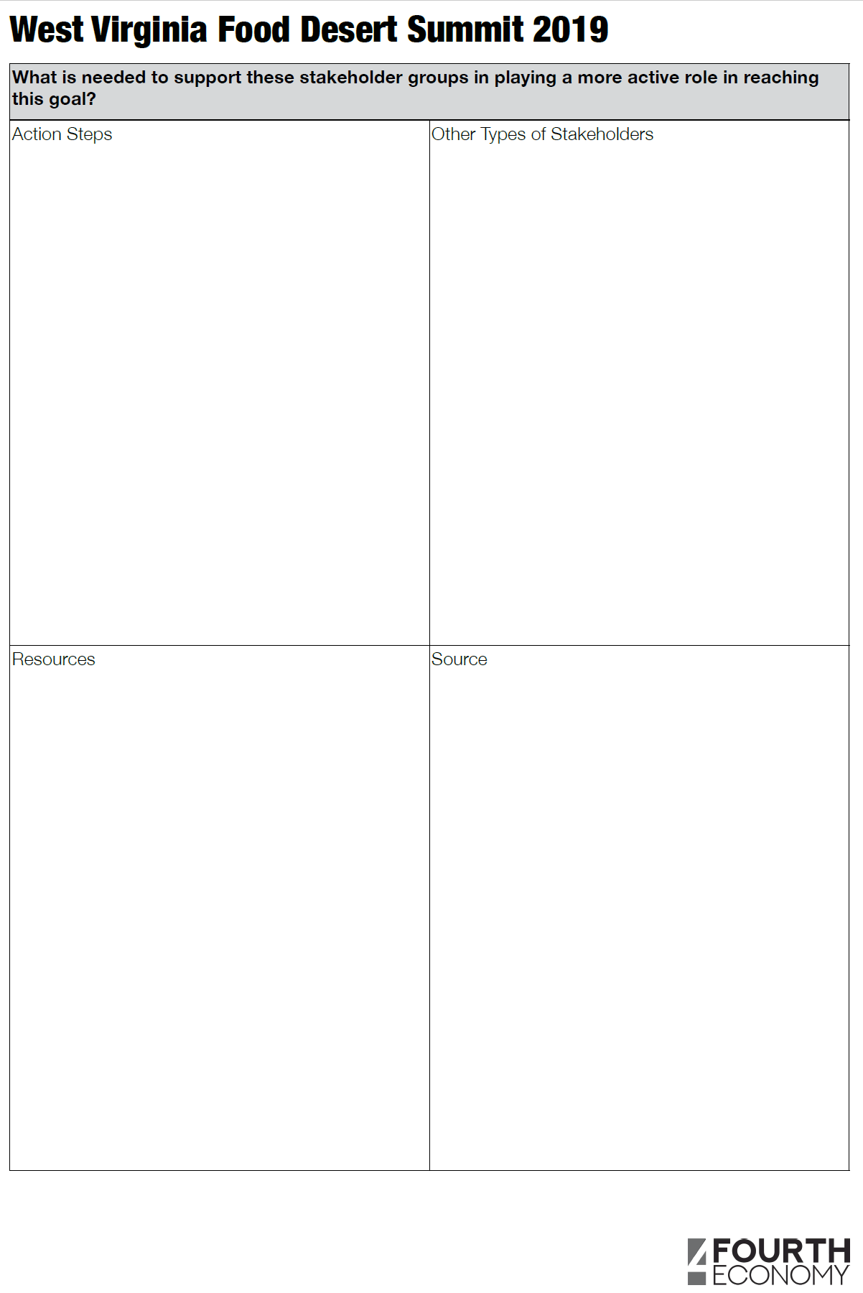


Slide 15
WVU Extension Family Nutrition Program
History with food access
Partnerships and infrastructure building in West Virginia
Notes:
Kids Markets
FARMacy
SNAP Stretch
Mobile Markets
Farm to Food Pantry
Local Retail (Spencer)

Slide 16

History
Two USDA-funded programs
EFNEP (~30 years)
Direct Nutrition Education
Limited resource youth and families
SNAP-Ed (~20 years)

Slide 17
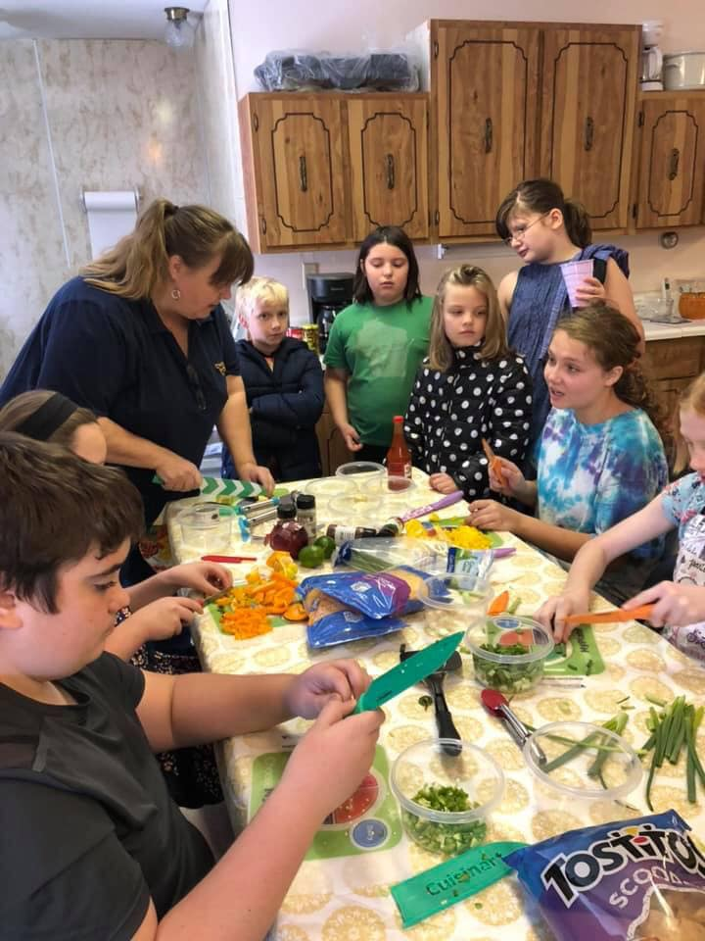
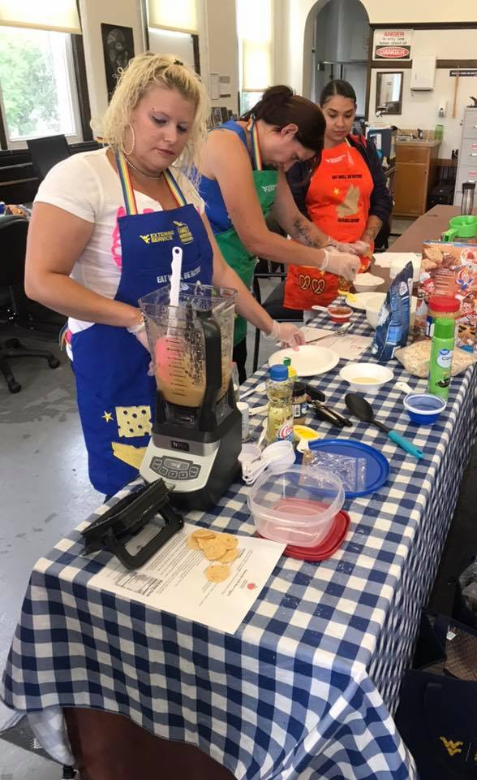
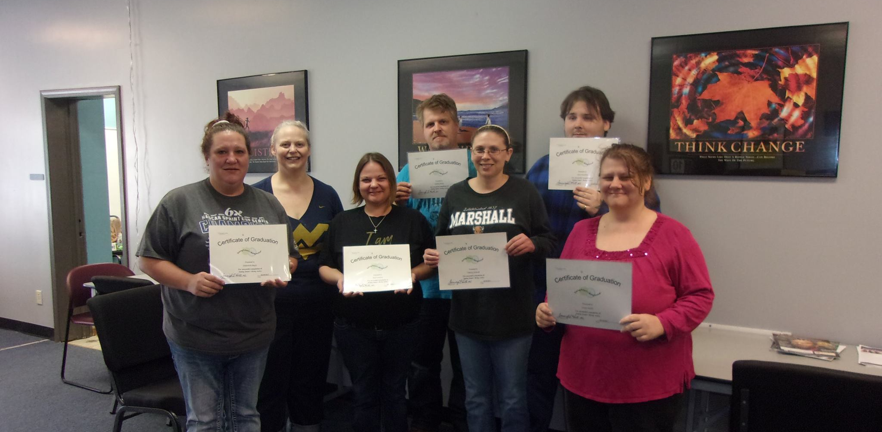
6-9 week nutrition education programs
  Schools (50% F/R meals), after school programs, camps
  Community centers, food pantries, adult education and training programs, libraries, public housing, health care facilities, etc.
    Behavioral change
      Diet quality
      Physical activity
      Food safety
      Food security
      Food resource management

Slide 18
Obesity Prevention Outreach
(Healthy Hunger-free Kids Act - 2010)
Public Health Specialist hired in 2013 (Kristin McCartney)
  Food Access Chair of the WV Food and Farm Coalition
  Opportunity to improve food access through integration of public health/nutrition education and the agricultural sector
    Support local farmers
    Build capacity within food systems
    Grow local food economy
    Create new access points to bring locally grown food to people in need

Slide 19
Obesity Prevention Outreach
(Healthy Hunger-free Kids Act - 2010)
  Launched the first Kids Market program in McDowell County (2014)
    Changed traditional farmers market to a mobile model – bring food to places where people were already gathered.
    Begun conversations about the need for aggregation and distribution networks

Slide 20
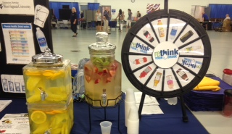
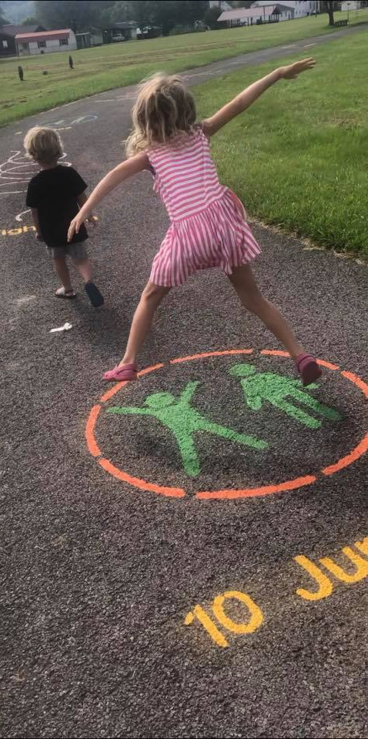
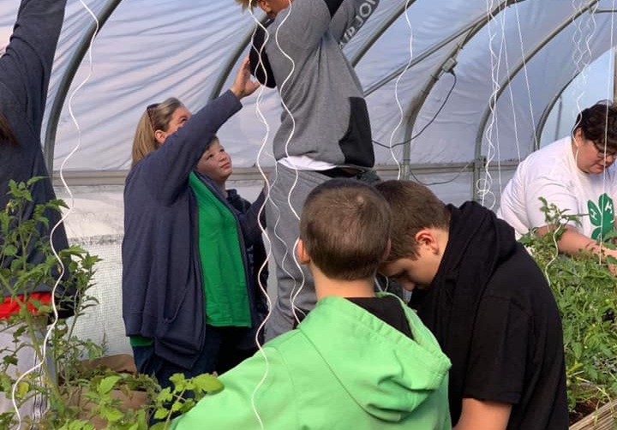
Obesity Prevention Outreach
Rethink Your Drink
Food of the Month
Grow This! WV Garden Challenge
School Gardens
Active Pathways
WV CARDIAC
Kids Markets
SNAP Stretch

Slide 21
40 Nutrition Outreach Instructors
and Health Educators covering 43 counties
HANCOCK
Family Nutrition Program Staffing 2021
BROOKE
OHIO
MARSHALL
WETZEL
MONONGALIA
MARION
MORGAN
PLEASANTS
TYLER
PRESTON
BERKELEY
HARRISON
TAYLOR
MINERAL
HAMPSHIRE
JEFFERSON
WOOD
DODDRIDGE
GRANT
RITCHIE
BARBOUR
WIRT
LEWIS
TUCKER
HARDY
CALHOUN
GILMER
JACKSON
ROANE
UPSHUR
RANDOLPH
MASON
BRAXTON
PENDLETON
PUTNAM
WEBSTER
CABELL
CLAY
KANAWHA
WAYNE
LINCOLN
NICHOLAS
POCAHONTAS
Youth Educator
BOONE
FAYETTE
Adult Educator
LOGAN
GREENBRIER
MINGO
RALEIGH
Youth and Adult Educator
WYOMING
SUMMERS
MONROE
No Educator
MCDOWELL
MERCER

Slide 22
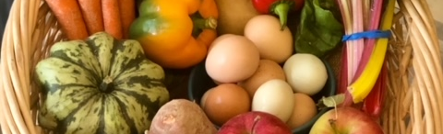
Growing the Local Food Economy
All produce is local
Allows farmers and aggregators to plan production
Create revenue stream for local growers

Slide 23
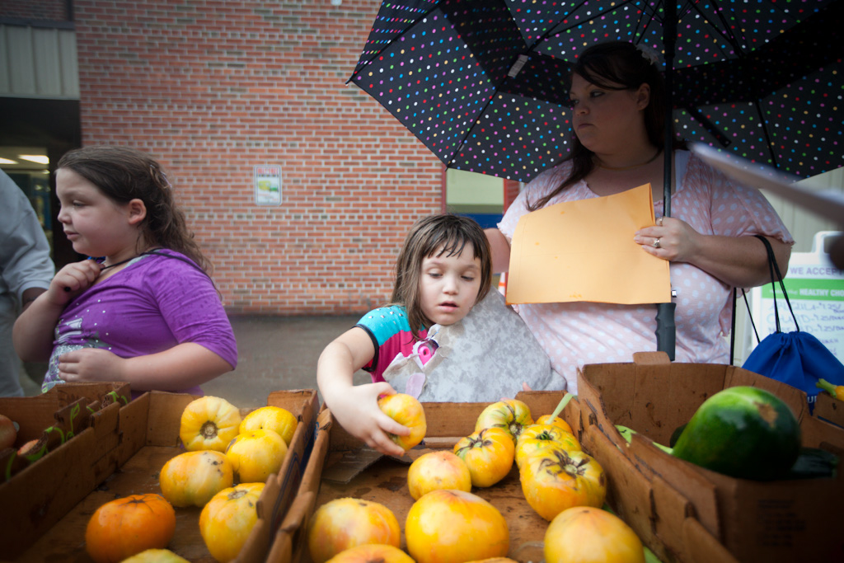
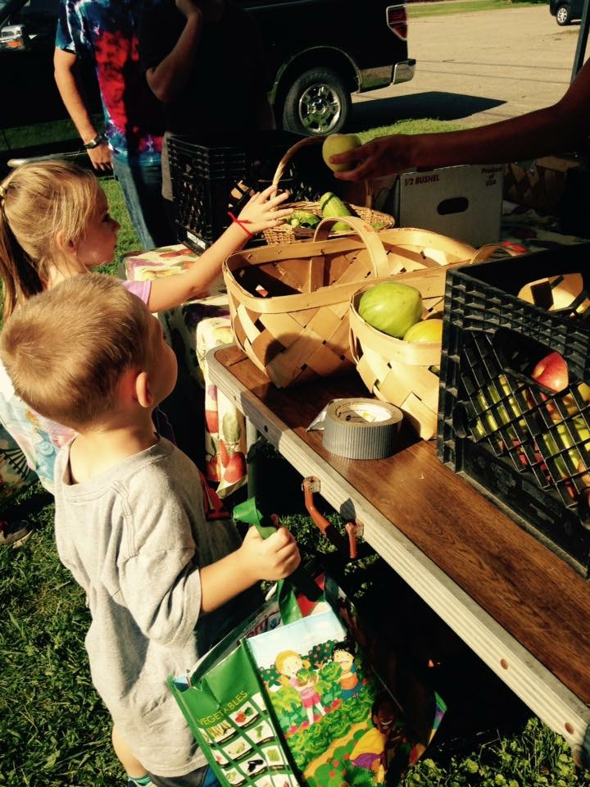
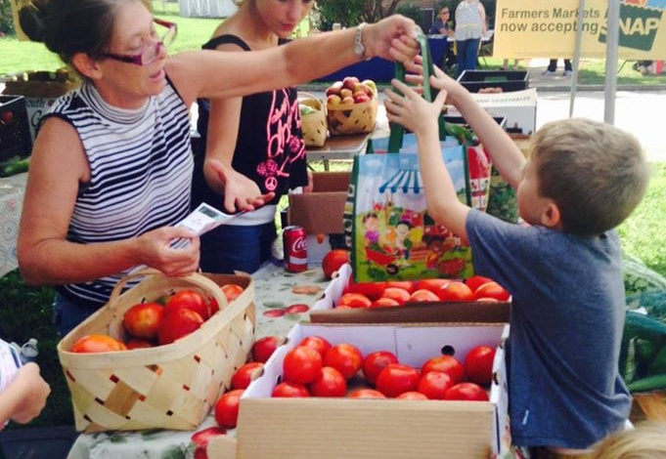
Kids Market Program
Local farmers market on-site at school
$4-6/student - shop for their own produce
Empower kids by giving them agency over their own food choices
Notes:
Kids Markets – farmers markets held on-site at school to help connect with local farmers and develop preferences for locally grown produce so they can take ownership over the purchase process.

Slide 24


Doubling and tripling of SNAP/EBT at farmers markets
EBT equipment for new markets/farmers
Offset transaction fees

Slide 25
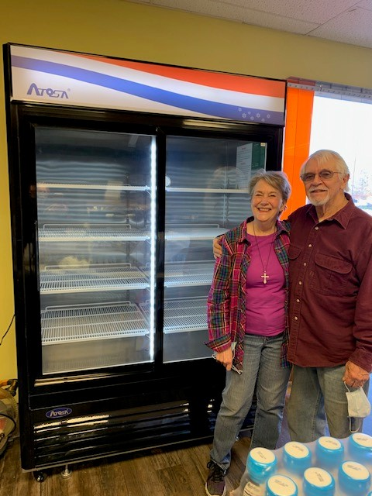
Farm to Food Pantry
Cold storage units for pantries
Identify sources for fresh produce
Provide assistance in developing initiatives to promote consumption fruits and vegetables
  Marketing
  Healthy donation policies
  Promote choice in food selection
  Nutrition education

Slide 26
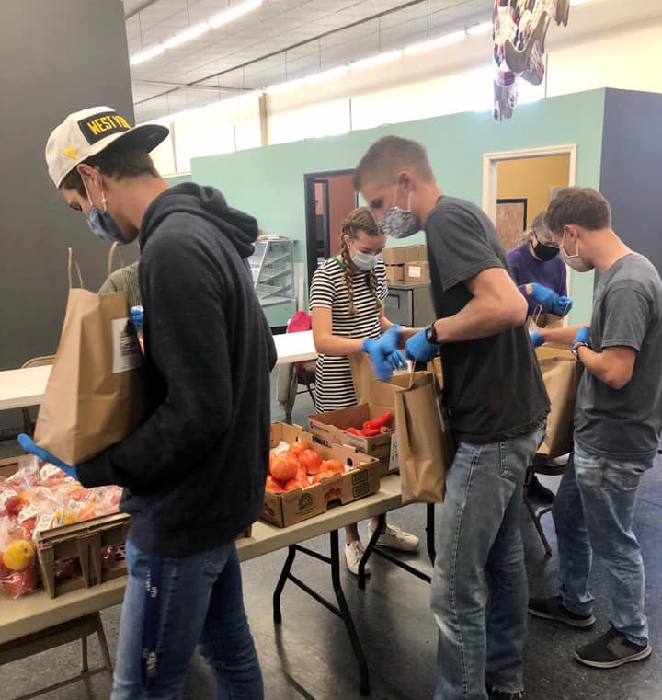
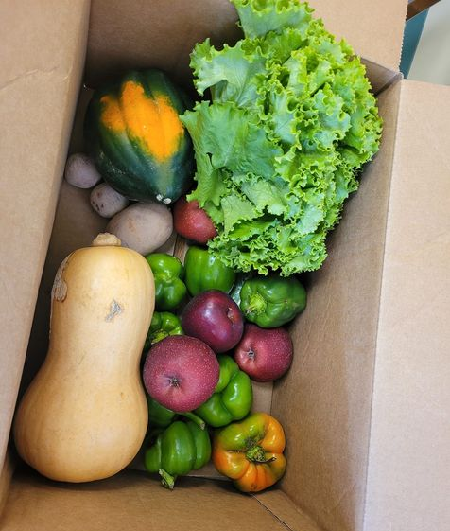
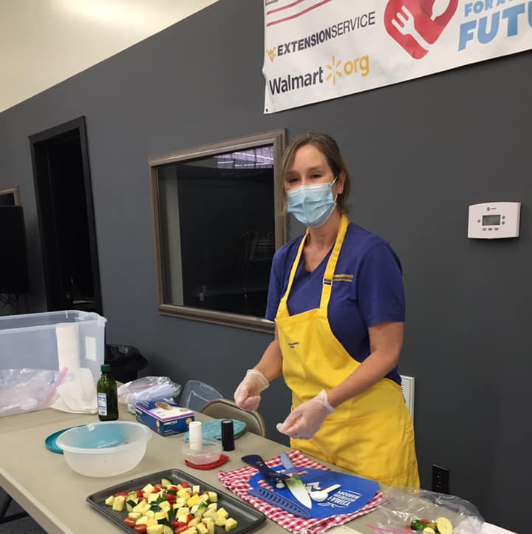
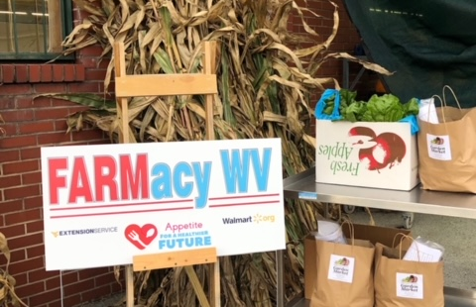
FARMacy
Connect people who experience food insecurity and chronic illness with locally grown fresh fruits and vegetables
Engage with providers, farmers and Extension educators weekly
15-week program @ $20/week
6 weeks of nutrition education
Measure changes in
  Clinical metrics
  Lifestyle behavior change
  Self efficacy
  Food insecurity

Slide 27
Nutrition Education
SNAP-Ed and EFNEP programs are interwoven into each intervention
Participants are involved in food preparation

Slide 28
















WV Farm 2 You
Notes:
Mention the great partners/initiatives that exist in the state to address food access

Slide 29
Questions for discussion…
Description of your initiative
  Region of West Virginia that you serve
  Who your initiative serves
  Partners involved
  Current sustainability/policy efforts
What is effective in addressing food deserts in West Virginia?
What does West Virginia’s food system look like?
Is there an ideal model of a food system?
Do our plans meet the needs of the most vulnerable in West Virginia (i.e. addressing availability, accessibility, adequacy, acceptability, and agency)?
Notes:
Food access partners in attendance…
Carla Toolan - Farm2You
James Vance - BPH
Lacy Davidson - WV Dept. of Agriculture
Georgiana Logan - Marshall University
Merinda Stricklen - KEYS
Spencer Moss – Food and Farm Coalition
FARMacy providers

Slide 30
Next steps…
We’d love to have a comprehensive idea of what food access initiatives exist in the state – are there any groups that you noticed are missing from today’s conversation?
WV Health Connection exists to support partners doing amazing work such as yourselves. Let us know if you’d ever like to showcase anything on our website, meet again on a food access-focused session like this, or discuss any technical assistance we might be able to offer.

Slide 31
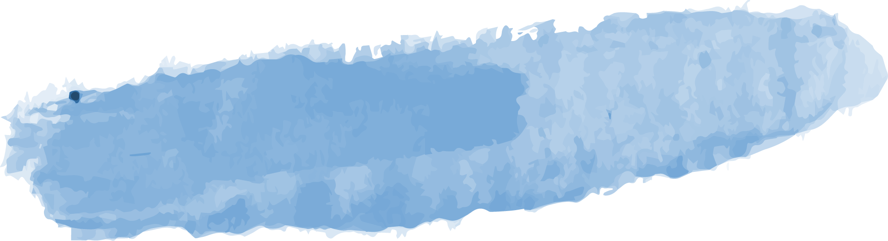
Upcoming WV Health Connection
Retreat Mini Sessions and Partner Trainings
1. Reimbursement ………..……………………………….………..…………….June 1st 1-2 PM
2. Prediabetes Standards of Care & SMBP ……………….….………….June 8th 1-2 PM
3. Introduction to Community Based Health Programs .........June 14th 12-1 PM
4. TOPS ………………………………………………….………………....…… June Partner Call
WISEWOMAN, Health Home, Diabetes Education/ Blood Pressure CPT codes
Marshall University & American Heart Association
Marshall University
Notes:
Audrey

Slide 32
Thank you for joining!
Q&A will follow this presentation
Notes:
Audrey

Slide 33

OHSR Contact Information
Adam Baus, PhD, MA, MPH – Director, Research Assistant Professor…………………..…………304-293-1083; abaus@hsc.wvu.edu
Cecil Pollard, MA – Assistant Director………………………………………………………...………304-293-1080; cpollard@hsc.wvu.edu
Samantha Shawley-Brzoska, PhD, MPH – Research Assistant Professor…………..……….. 304-293-0189; sshawley@hsc.wvu.edu
Andrea Calkins, MPH – Program Coordinator…………………………………..………………… 304-293- 3845; alcalkins@hsc.wvu.edu
Audrey Semel, MPH – Research Assistant…………………………………………….…….. 304-581-1406; audrey.semel@hsc.wvu.edu
Traci Jarrett, PhD – Research Assistant Professor………………………………...….……………. 859-323-4709; tjarrett@hsc.wvu.edu
Mary Swim, BA – Business Research Analyst……………………………………..………………… 304-293-1079; mswim@hsc.wvu.edu
Divya Gadde, MS – Database Administrator……………………………………..…………….. 304-293-4606; divya.gadde@hsc.wvu.edu
Lakin Davis, MPH – Research Assistant…………………………………………..………………….. 304-293-2756; lsdavis@hsc.wvu.edu
Notes:
Audrey

Slide 34
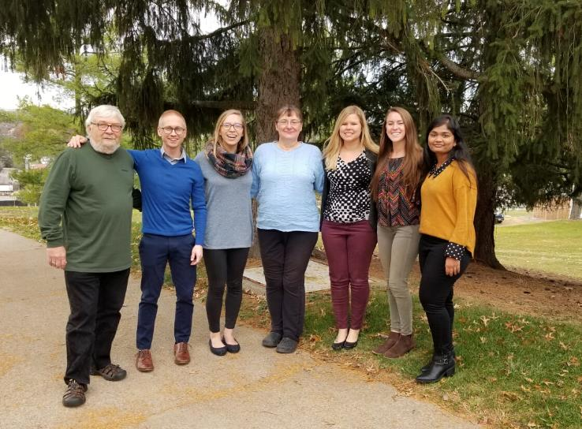


Ways to learn more
Visit our website at wvhealthconnection.com
Email us at wvhealthconnection@gmail.com
Follow us on Facebook (@WVHealthConnection)
The WVU Office of Health Services Research team
(From left to right) Cecil Pollard, Adam Baus, Audrey Semel, Mary Swim, Samantha Shawley-Brzoska, Andrea Calkins, and Divya Gadde
Notes:
Audrey

