Slide 1
Retreat Mini Session #1 WORKPLACE WELLNESS
With Veronica Crosier at Active Southern WV
May 10th, 2021, 1-2PM
Notes:
Audrey

Slide 2
Introduce yourself in the chat box!
Notes:
Audrey
Poll 1 (Lakin)

Slide 3
WV Health Connection
Helping to address our long-standing challenges in integrating and mobilizing across clinical and community settings for the sake of individuals, families and community/ population health
Direct technical assistance to clinical and community-based partners
Supports:
Knowledge of available community-based programming
Willingness and ability to refer to program offerings
Ability to measure effectiveness of programming and demonstrate value
Communication and therefore collaboration
Sense of a collective response to critical public health issues in communities, regions, and the state
Notes:
Samantha

Slide 4
Sincere thanks to our funders and supporters!

Slide 5
Workplace Wellness
With Veronica Crosier at Active Southern WV
Notes:
Audrey/Lakin

Slide 6
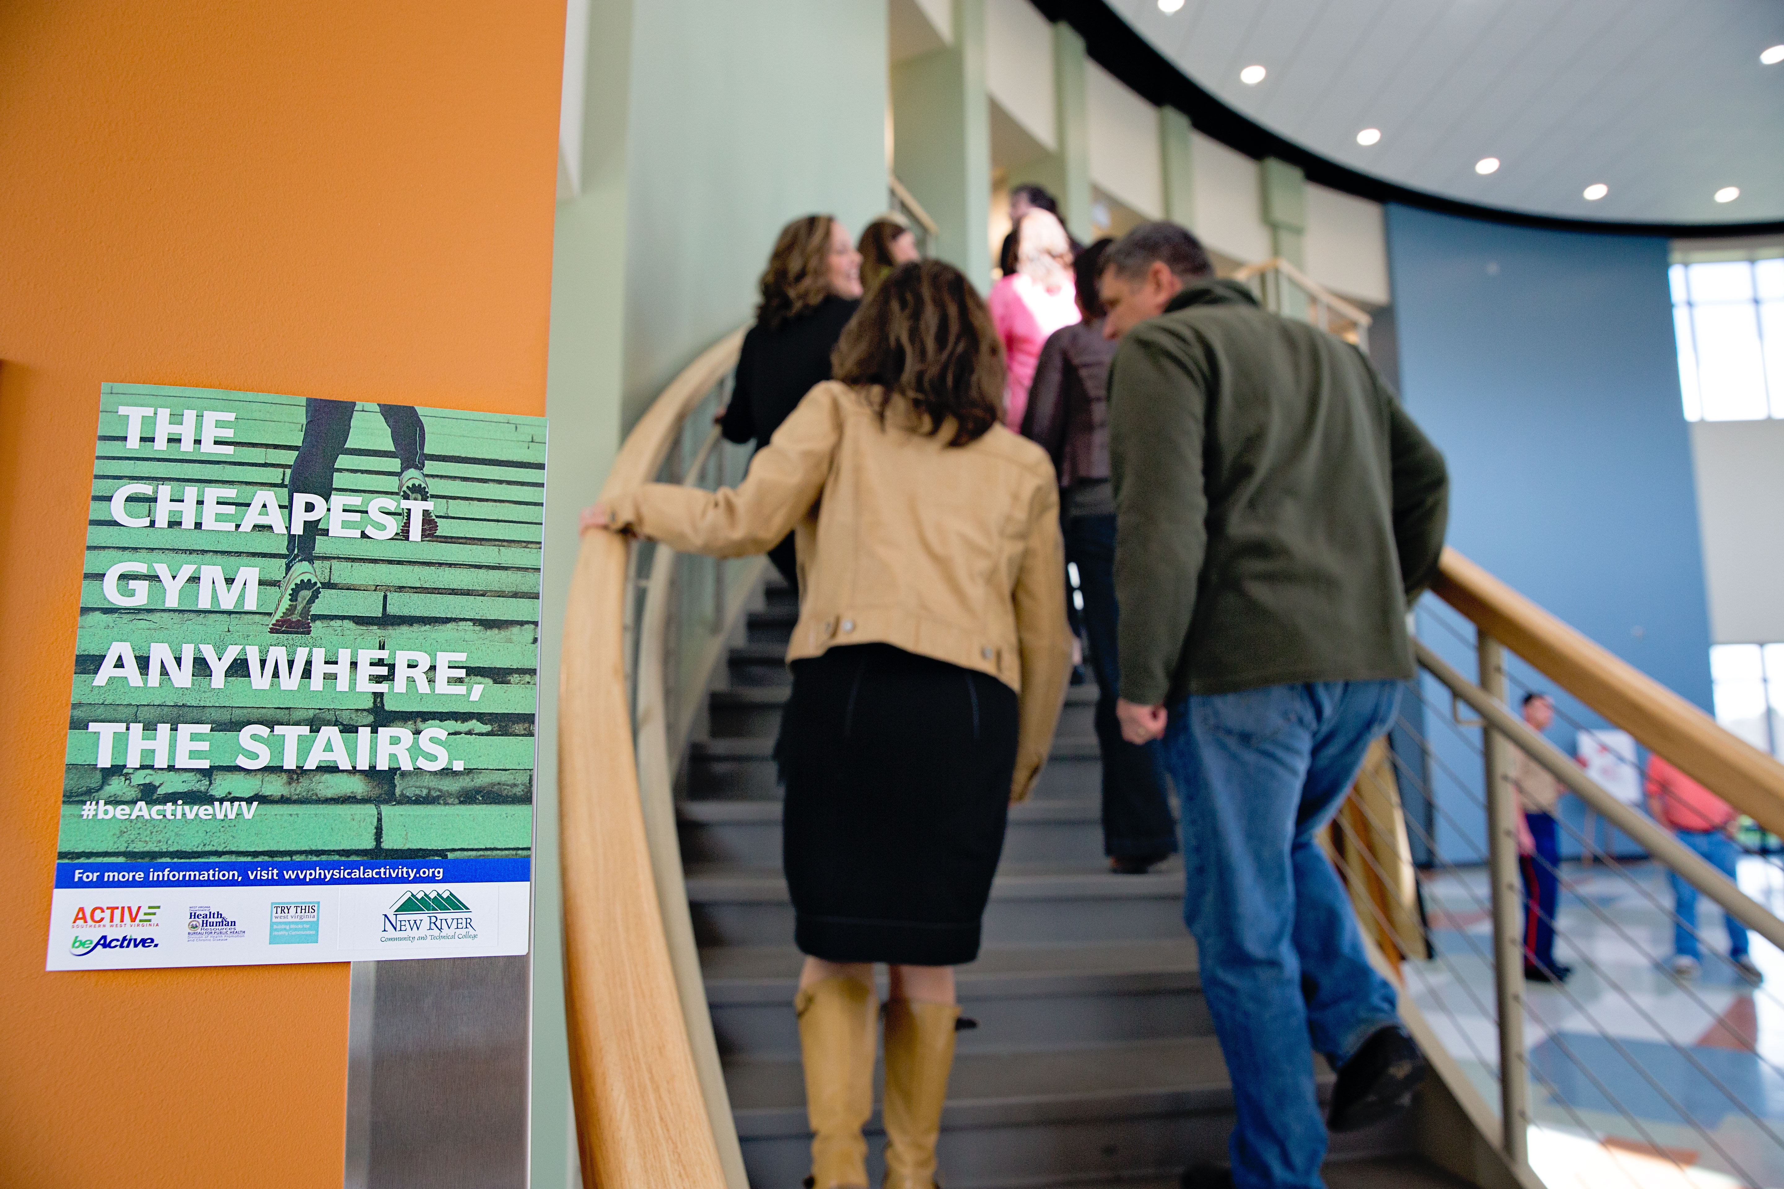
Active SWV Workplace Wellness Program
Benefits
Access to resources
Improve wellness offerings
See increase in employees’ actual and perceived wellness
Implement at least on Policy, System, & Environment Change
Foundation to provide wellness for years to come
Resources
Presentations & workshops
Technical Assistance
3rd Party Survey Distribution/Data Aggregation
Educational Materials
Media Recognition
Courses & Certifications
Funding Opportunities

Slide 7
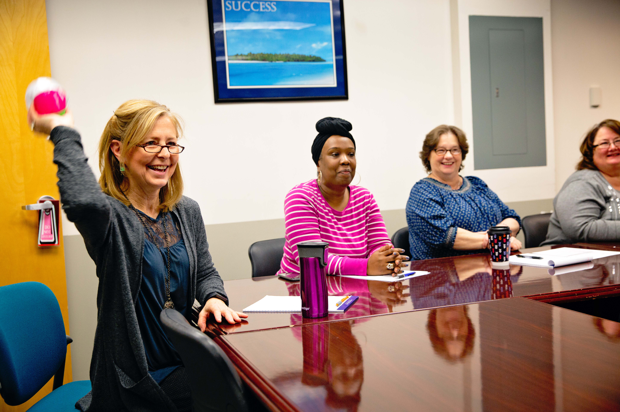
Creating Your Program
CDC Work@Health
Grant Funding
Workplace Wellness Membership

Slide 8
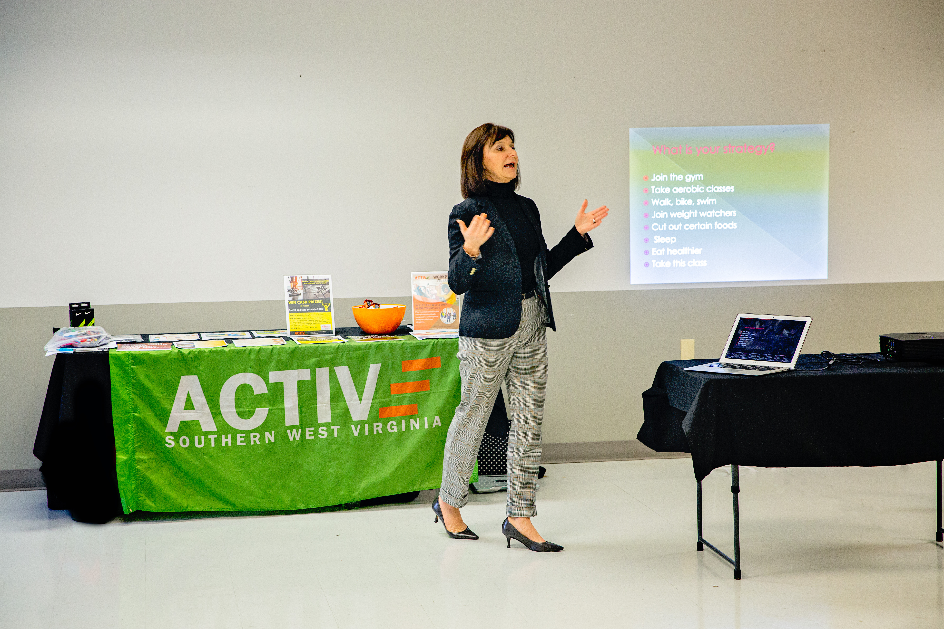
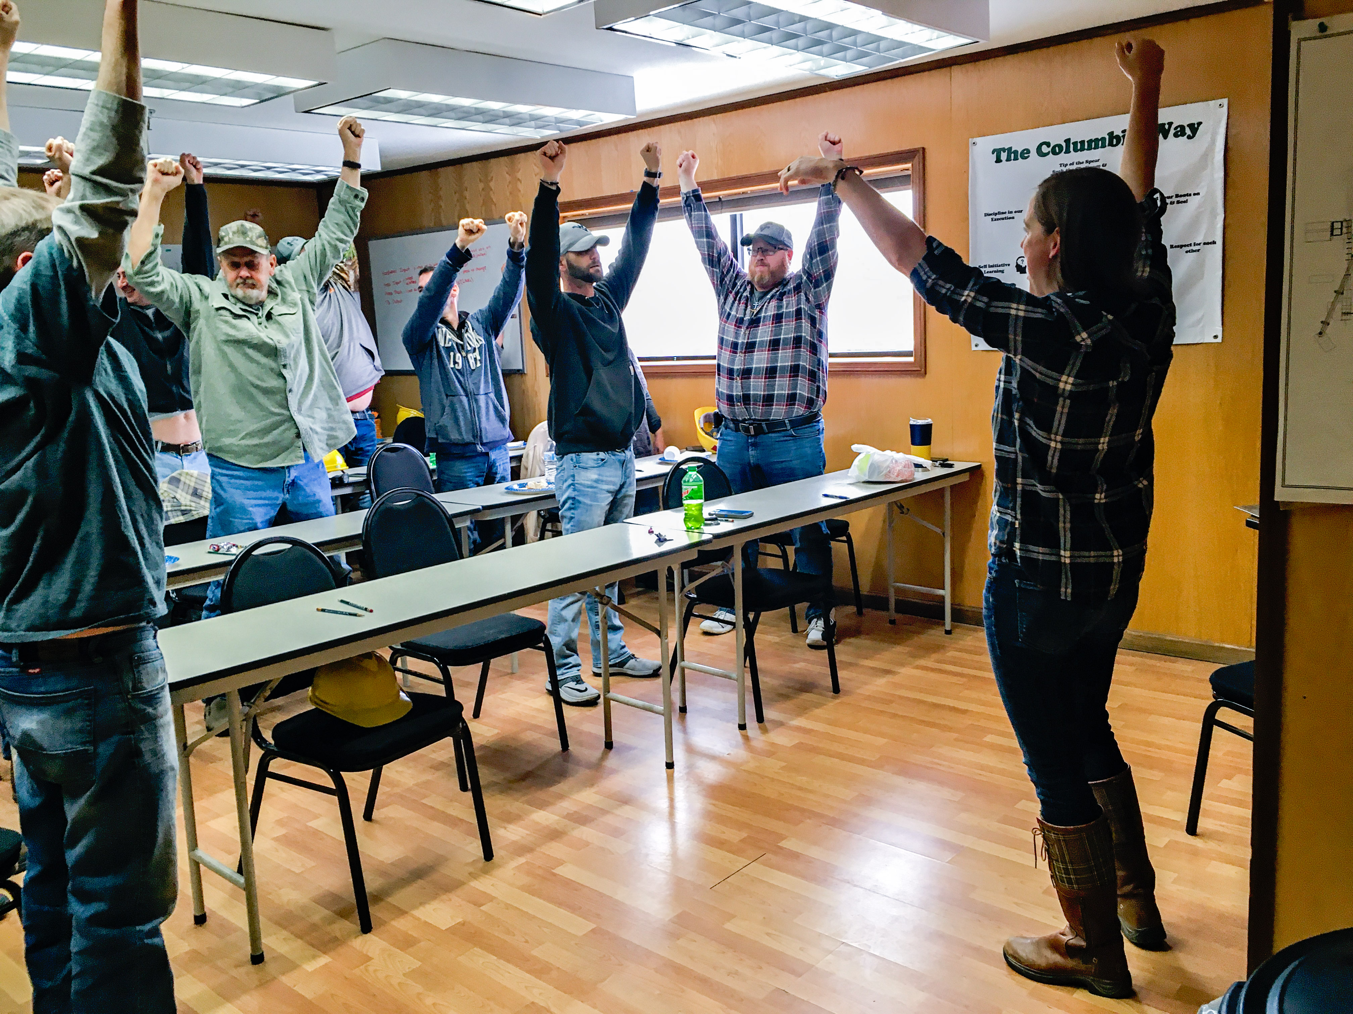
Work@Health Employer Training June 16th 1pm
CDC Evidence Based
Time Commitment
6-8 Weeks; 2-4 hours/week
Benefits
Complete health assessment of your workplace
Train to develop health interventions
Technical assistance
Tools to create 1 year action plan
Qualify for funding

Slide 9
Active SWV & WV HPCD Mini Grants mid-July 2021
$1000 to jumpstart your program
Must have 1 Work@Health certified employee
Implement one Policy, System and Environment change

Slide 10
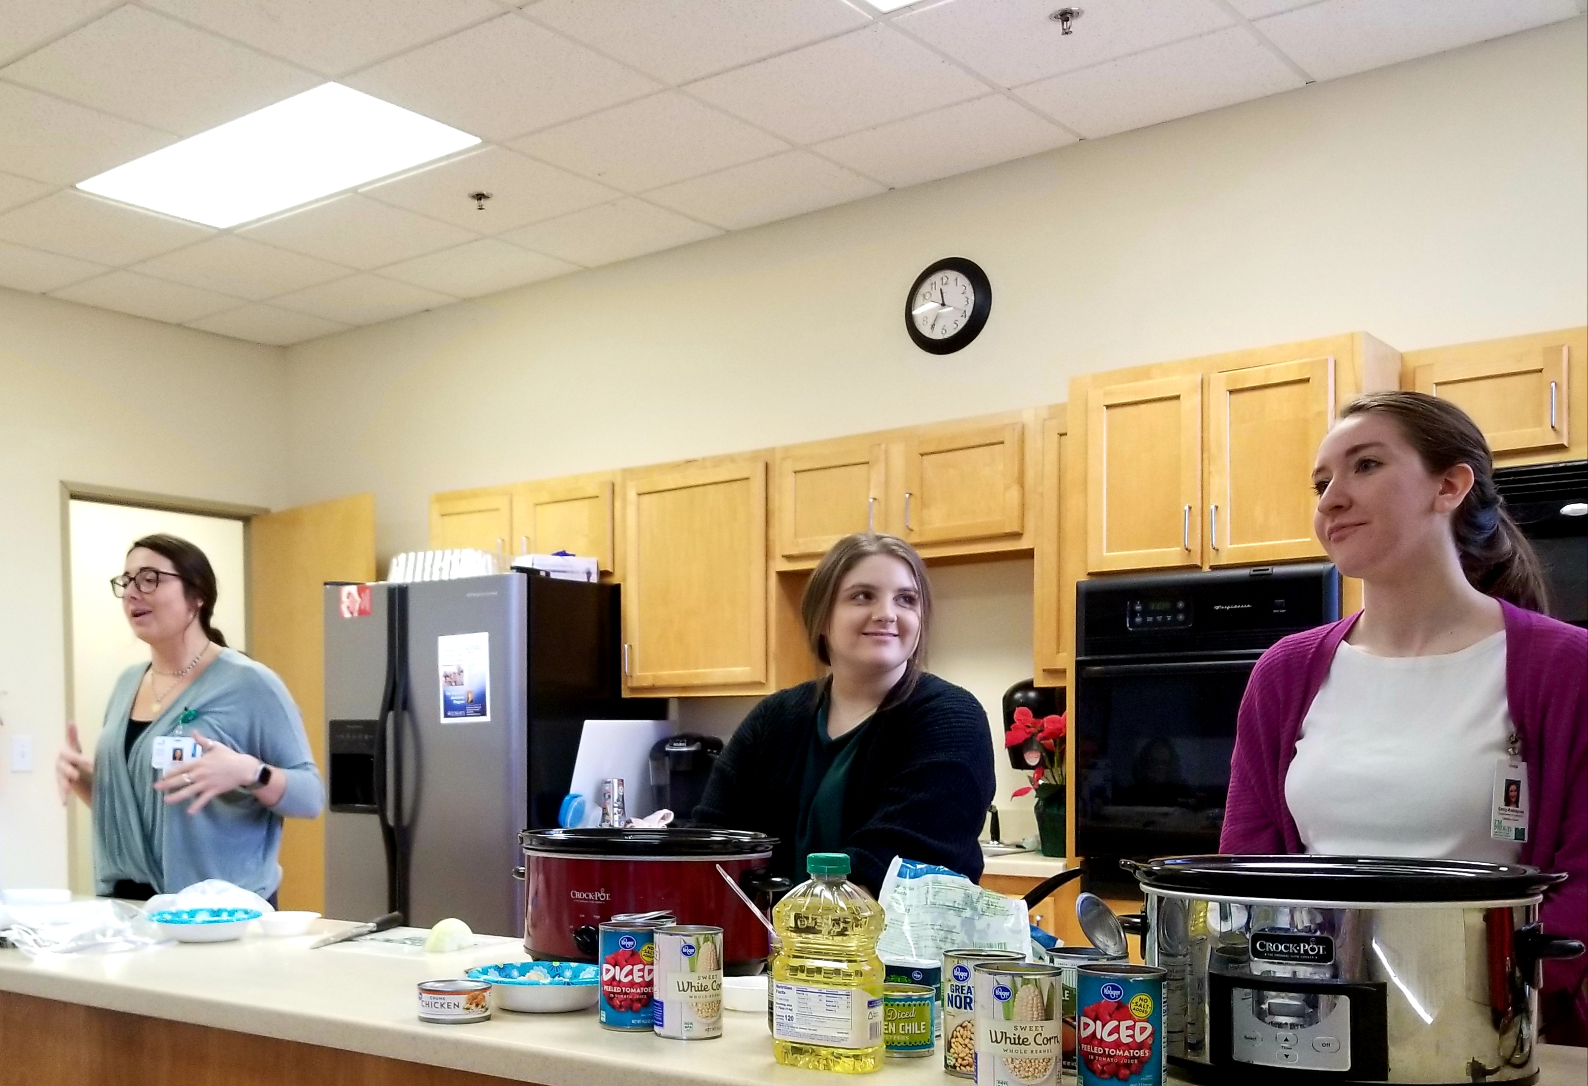
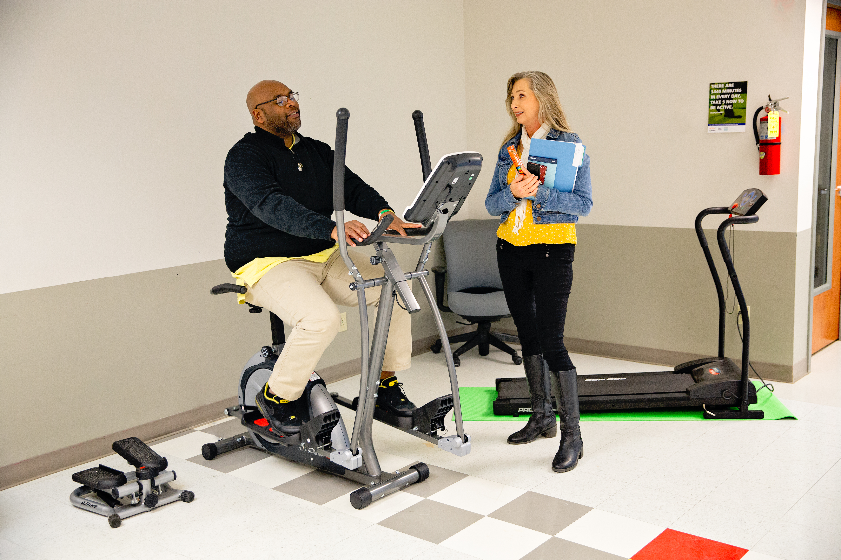
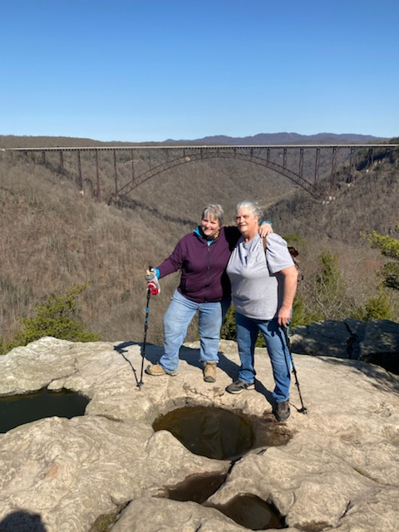
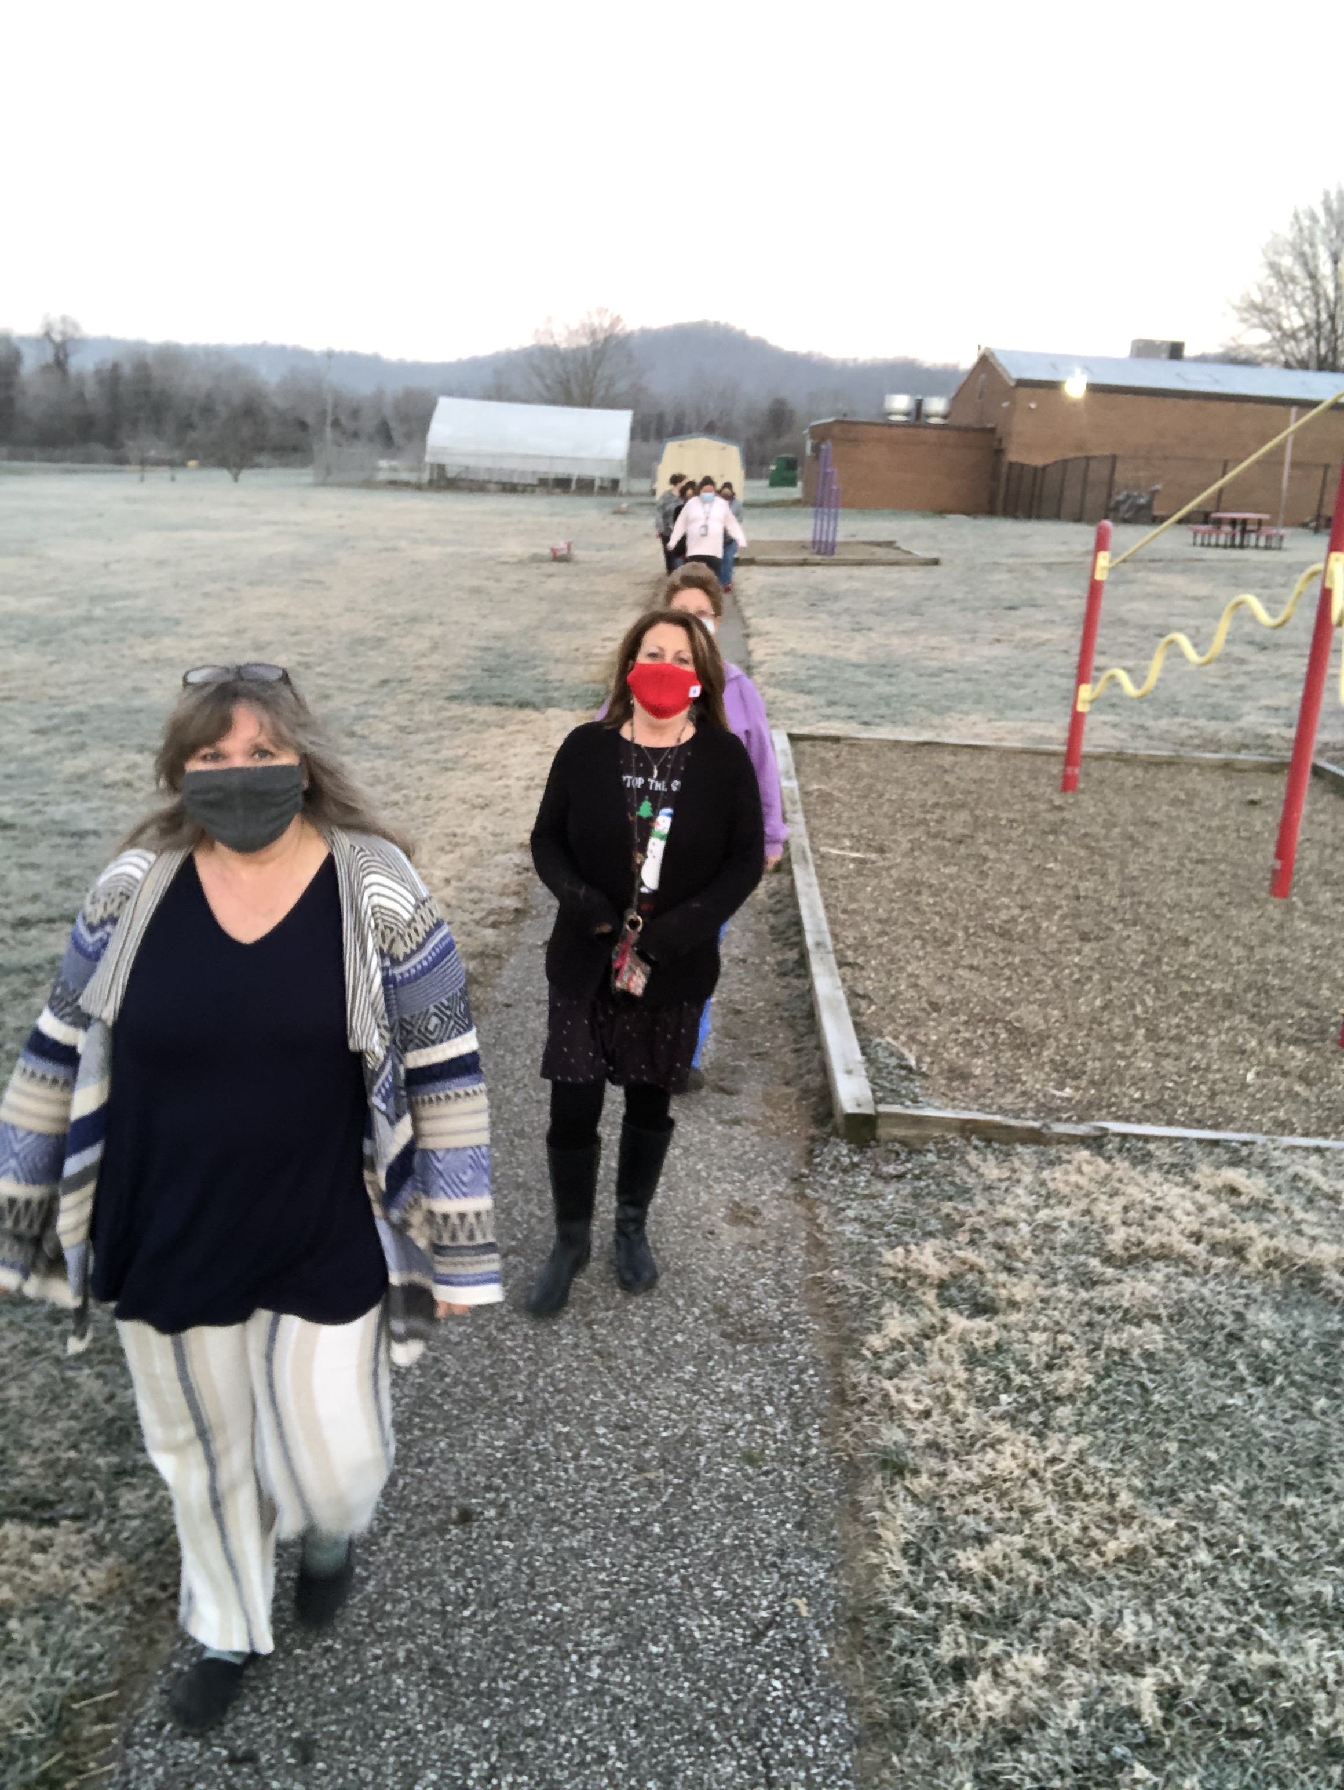
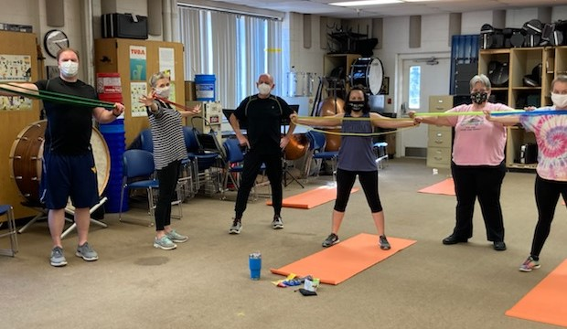
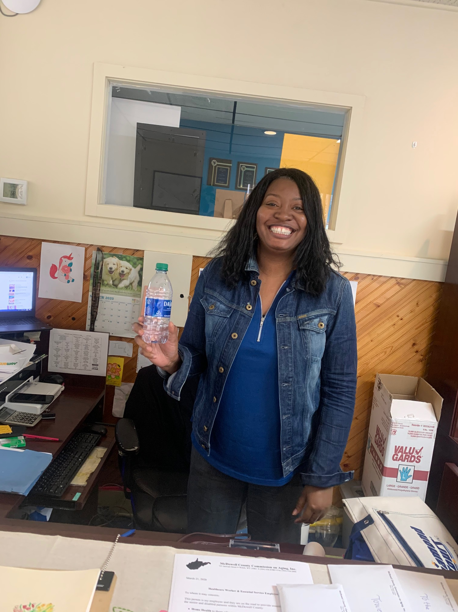
“I didn't know Kay very well before this program, and now we have become exercise pals. We talk each day and motivate each other to keep working. Kay is my hero and friend.”
– Tracy Wayne, Clay Middle School
“We knew there was going to be some resistance in the beginning, but as we began to bring in more equipment and they saw the environment changing, you could see and hear the mindset changing. Many people have started a weight loss group and are supporting each other…there is an increasing interest in what we will do next and how they can get involved.”
– Ashley Starcher, Old Colony Company of GKV
“The faculty and staff at Sutton Elementary School has totally embraced the workplace wellness idea! We have several teachers that have lost weight, a group that is now walking, and you see our water bottles on almost every desk! Health and wellness signs are up in our elevator, hallways, and teacher mailbox area. Every Friday, the PE teacher is doing a yoga class and the staff receives a weekly exercise and yoga video.”
– Susan Schiefer, Sutton Elementary

Slide 11
We couldn’t do it without WVHC!
Data Collection & Analysis
3rd Party Survey Collection
300 + Employee Assessments
Employee Self-referral
WWE, NDPP – Workshop Wizard
Personalized tech assistance for grantees
Easy reports
Continue to integrate Workshop Wizard to help workplaces track attendance for custom programs
Connect Employees to Wellness Programs
Class Map
Walk With Ease
National Diabetes Prevention Program

Slide 12
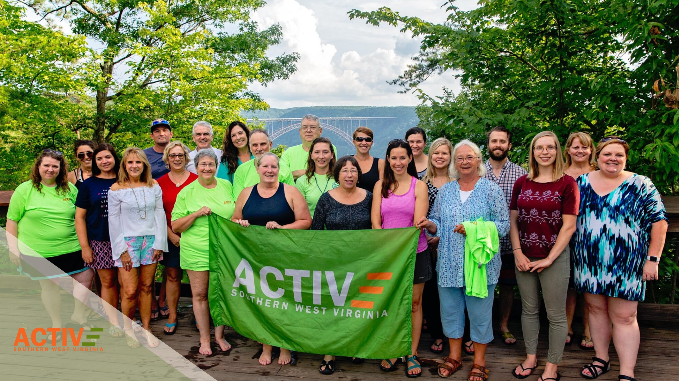
Remember:
Work@Health
June 16th 1pm
$1k Grants mid-July
Ask how we can get you started!
Veronica Crosier
Workplace Wellness Director, ASWV
veronica@activeswv.com

Slide 13
Upcoming WV Health Connection Retreat Mini Sessions
DPP New Standards ………………..……………………………………………….May 17th 1-2 PM
Food Access Initiatives ……………………………………………..……………..May 24th 1-2 PM
Reimbursement ……………………………………………………………..………….June 1st 1-2 PM
WISEWOMAN, Health Home, Diabetes Education/ Blood Pressure CPT codes
Notes:
Audrey

Slide 14
Thank you for joining! Q&A will follow this presentation
Notes:
Audrey

Slide 15
OHSR Contact Information
Adam Baus, PhD, MA, MPH – Director, Research Assistant Professor…………………..…………304-293-1083; abaus@hsc.wvu.edu
Cecil Pollard, MA – Assistant Director………………………………………………………...………304-293-1080; cpollard@hsc.wvu.edu
Samantha Shawley-Brzoska, PhD, MPH – Research Assistant Professor…………..……….. 304-293-0189; sshawley@hsc.wvu.edu
Andrea Calkins, MPH – Program Coordinator…………………………………..………………… 304-293- 3845; alcalkins@hsc.wvu.edu
Audrey Semel, MPH – Research Assistant…………………………………………….…….. 304-581-1406; audrey.semel@hsc.wvu.edu
Traci Jarrett, PhD – Research Assistant Professor………………………………...….……………. 859-323-4709; tjarrett@hsc.wvu.edu
Mary Swim, BA – Business Research Analyst……………………………………..………………… 304-293-1079; mswim@hsc.wvu.edu
Divya Gadde, MS – Database Administrator……………………………………..…………….. 304-293-4606; divya.gadde@hsc.wvu.edu
Lakin Davis, MPH – Research Assistant…………………………………………..………………….. 304-293-2756; lsdavis@hsc.wvu.edu
Notes:
Audrey

Slide 16
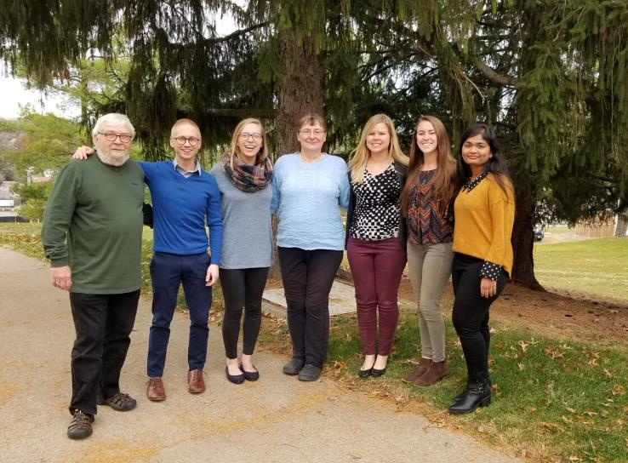
Ways to learn more
Visit our website at wvhealthconnection.com
Email us at wvhealthconnection@gmail.com
Follow us on Facebook (@WVHealthConnection)
The WVU Office of Health Services Research team
(From left to right) Cecil Pollard, Adam Baus, Audrey Semel, Mary Swim, Samantha Shawley-Brzoska, Andrea Calkins, and Divya Gadde
43
Notes:
Audrey

