Slide 1
Retreat Mini Session #2 DPP New Standards
May 17th, 2021, 1-2PM
Notes:
Audrey

Slide 2
Introduce yourself in the chat box!
3
Notes:
Audrey
Poll 1 (Lakin)

Slide 3
WV Health Connection
Helping to address our long-standing challenges in integrating and mobilizing across clinical and community settings for the sake of individuals, families and community/ population health
Direct technical assistance to clinical and community-based partners
Supports:
Knowledge of available community-based programming
Willingness and ability to refer to program offerings
Ability to measure effectiveness of programming and demonstrate value
Communication and therefore collaboration
Sense of a collective response to critical public health issues in communities, regions, and the state
Notes:
Samantha

Slide 4
Sincere thanks to our funders and supporters!

Slide 5
DPP New Standards
Notes:
Audrey/Lakin

Slide 6
Upcoming WV Health Connection Retreat Mini Sessions
Food Access Initiatives ……………………………………………..……………..May 24th 1-2 PM
Reimbursement ……………………………………………………………..………….June 1st 1-2 PM
WISEWOMAN, Health Home, Diabetes Education/ Blood Pressure CPT codes
Notes:
Audrey

Slide 7
Thank you for joining! Q&A will follow this presentation
Notes:
Audrey

Slide 8
OHSR Contact Information
Adam Baus, PhD, MA, MPH – Director, Research Assistant Professor…………………..…………304-293-1083; abaus@hsc.wvu.edu
Cecil Pollard, MA – Assistant Director………………………………………………………...………304-293-1080; cpollard@hsc.wvu.edu
Samantha Shawley-Brzoska, PhD, MPH – Research Assistant Professor…………..……….. 304-293-0189; sshawley@hsc.wvu.edu
Andrea Calkins, MPH – Program Coordinator…………………………………..………………… 304-293- 3845; alcalkins@hsc.wvu.edu
Audrey Semel, MPH – Research Assistant…………………………………………….…….. 304-581-1406; audrey.semel@hsc.wvu.edu
Traci Jarrett, PhD – Research Assistant Professor………………………………...….……………. 859-323-4709; tjarrett@hsc.wvu.edu
Mary Swim, BA – Business Research Analyst……………………………………..………………… 304-293-1079; mswim@hsc.wvu.edu
Divya Gadde, MS – Database Administrator……………………………………..…………….. 304-293-4606; divya.gadde@hsc.wvu.edu
Lakin Davis, MPH – Research Assistant…………………………………………..………………….. 304-293-2756; lsdavis@hsc.wvu.edu
Notes:
Audrey

Slide 9
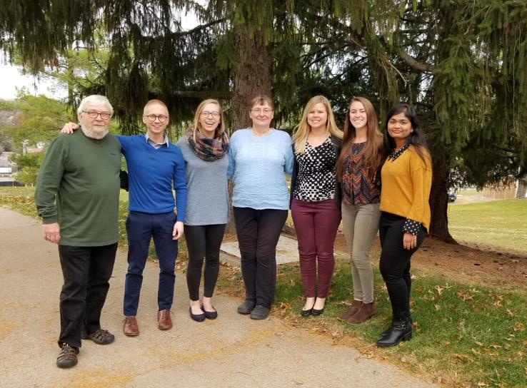
Ways to learn more
Visit our website at wvhealthconnection.com
Email us at wvhealthconnection@gmail.com
Follow us on Facebook (@WVHealthConnection)
The WVU Office of Health Services Research team
(From left to right) Cecil Pollard, Adam Baus, Audrey Semel, Mary Swim, Samantha Shawley-Brzoska, Andrea Calkins, and Divya Gadde
43
Notes:
Audrey

